Slide 1
Module 5 network security and applications

Slide 2
Why do we need Security?
Protect vital information while still allowing access to those who need it
Provide authentication and access control for resources
Guarantee availability of resources

Slide 3
network Security?
Computer networks are typically a shared resource used by many applications representing different interests.
The internet is particularly widely shared, being used by many people including opportunistic criminals.
Unless security measures are taken, a network conversation or a distributed application may be compromised by an adversary

Slide 4
Network attacks
Packet sniffing
ARP spoofing
Port scanning
IP spoofing

Slide 5
Packet sniffing
To transfer data from a source to a destination via computer network, the data needs to broken into smaller unit at the source, these smaller units are reffered as data packets, and are reassembled at the destination.
The act of capturing data packet across the network is reffered to as packet sniffing.
It is used by hackers to collect information illegally about network.
Eve
Network
Alice
Bob

Slide 6
Why are Packet sniffers used?
Detection of clear-text passwords and usernames from the network.
Conversion of data to human readable format so that people can read the traffic.
Performance analysis to discover network bottlenecks.
Troubleshoot network related problems
Network intrusion detection in order to discover hackers.

Slide 7
Arp spoofing
In ARP spoofing, hacker sends false ARP message over LAN, which results in linking attackers MAC address with the IP address of a legitimate computer on the network.
Once the attackers MAC address is connected to the authentic IP address, the attacker will start receiving data that are intended for that IP address.
ARP spoofing attack can only occur on LAN that utilizes ARP.

Slide 8
Arp spoofing
primarily used to translate IP addresses to ethernet MAC addresses
the device drive for ethernet nic needs to do this to send a packet
also used for IP over other LAN technologies, e.g. IEEE 802.11
each host maintains a table of ip to mac addresses
message types:
ARP request
ARP reply
ARP announcement

Slide 9
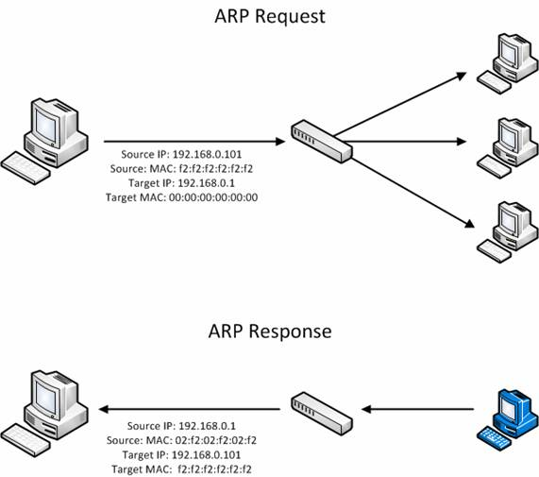
Arp spoofing

Slide 10
Arp spoofing
IP: 192.168.1.1
MAC: 00:11:22:33:44:01
IP: 192.168.1.105
MAC: 00:11:22:33:44:02
Data
192.168.1.1 is at 00:11:22:33:44:01
192.168.1.105 is at 00:11:22:33:44:02
ARP Cache
192.168.1.105 | 00:11:22:33:44:02
ARP Cache
192.168.1.1 | 00:11:22:33:44:01

Slide 11
Arp spoofing
The ARP table is updated whenever an ARP response is received
Requests are not tracked
ARP announcements are not authenticated
Machines trust each other
A rogue machine can spoof other machines

Slide 12
Arp spoofing (arp poisoning)
According to the standard, almost all ARP implementations are stateless
An ARP cache updates every time that it receives an ARP reply… even if it did not send any ARP request!
It is possible to “poison” an ARP cache by sending gratuitous ARP replies

Slide 13
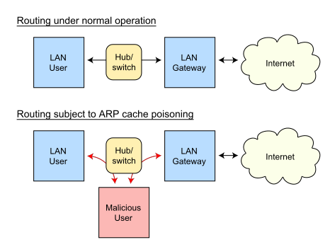
Arp spoofing (arp poisoning)
Send fake or 'spoofed', ARP messages to an Ethernet LAN.
To have other machines associate IP addresses with the attacker’s MAC
Legitimate use
redirect a user to a registration page before allow usage of the network.
Implementing redundancy and fault tolerance

Slide 14
Arp spoofing
192.168.1.106
00:11:22:33:44:03
Data
Data
192.168.1.105 is at 00:11:22:33:44:03
192.168.1.1 is at 00:11:22:33:44:03
192.168.1.1
00:11:22:33:44:01
192.168.1.105
00:11:22:33:44:02
Poisoned ARP Cache
192.168.1.105 | 00:11:22:33:44:03
Poisoned ARP Cache
192.168.1.1 | 00:11:22:33:44:03

Slide 15
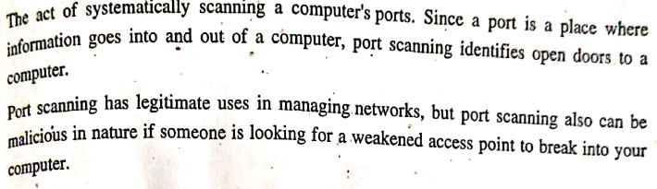
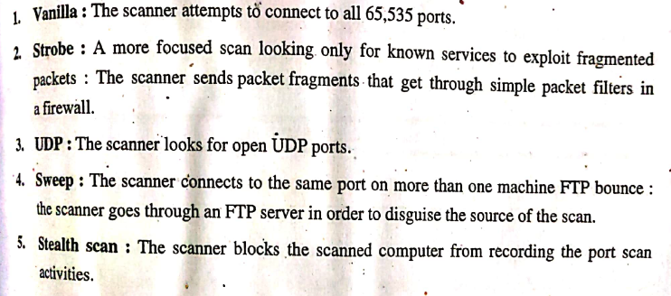
Port scannig
Types of Port Scans

Slide 16
Ip spoofing
An attacker sends IP packets from a false (or “spoofed”) source address in order to disguise itself.
Denial-of-service attacks often use IP spoofing to overload networks and devices with packets that appear to be from legitimate source IP addresses.
There are two ways that IP spoofing attacks can be used to overload targets with traffic.
One method is to simply flood a selected target with packets from multiple spoofed addresses.
This method works by directly sending a victim more data than it can handle.

Slide 17
Ip spoofing
The other method is to spoof the target’s IP address and send packets from that address to many different recipients on the network.
When another machine receives a packet, it will automatically transmit a packet to the sender in response.
Since the spoofed packets appear to be sent from the target’s IP address, all responses to the spoofed packets will be sent to (and flood) the target’s IP address.

Slide 18
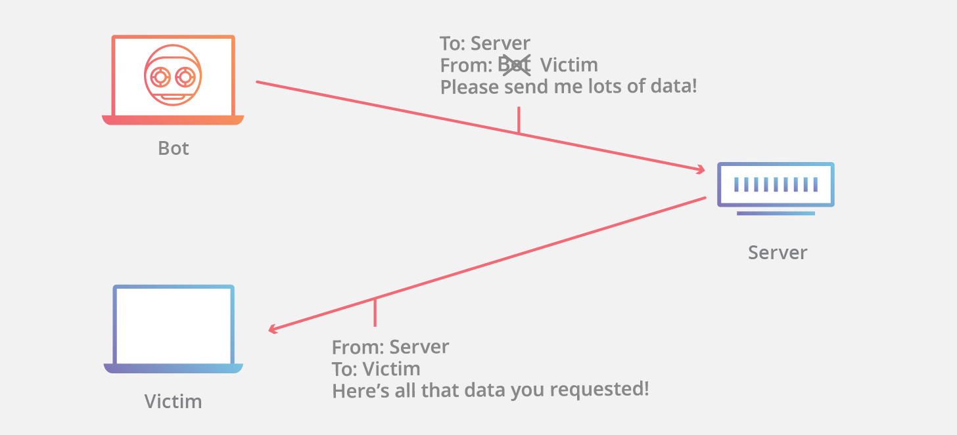
Ip spoofing
IP spoofing is the creation of internet protocol (IP) packets which have a modified source address in order to either hide the identity of the sender, to impersonate another computer system, or both. It is a technique often used by bad actors to invoke DDOS attacks against a target device or the surrounding infrastructure.
Fig.1. User ID and password file

Slide 19
Ip spoofing
How to protect against IP spoofing ?
https://www.cloudflare.com/en-in/learning/ddos/glossary/ip-spoofing/
Types of IP Spoofing Attacks ?
https://www.keyfactor.com/blog/what-it-is-ip-spoofing-how-to-protect-against-it/

Slide 20
Denial of service (Dos) attack
Dos attacks typically function by overwhelming or flooding a targeted machine with requests until normal traffic is unable to be processed, resulting in denial-of-service to addition users. A dos attack is characterized by using a single computer to launch the attack.
There are two general methods of dos attacks: flooding services or crashing services. Flood attacks occur when the system receives too much traffic for the server to buffer, causing them to slow down and eventually stop.
Popular flood attacks include:
Buffer overflow attacks
ICMP flood
Syn flood

Slide 21
Flood attack: buffer overflow
Buffer overflow attacks – the most common dos attack. The concept is to send more traffic to a network address than the programmers have built the system to handle. It includes the attacks listed below, in addition to others that are designed to exploit bugs specific to certain applications or networks

Slide 22
Flood attack: ICMP
ICMP flood –
A ping flood is a denial-of-service attack in which the attacker attempts to overwhelm a targeted device with ICMP echo-request packets, causing the target to become inaccessible to normal traffic. When the attack traffic comes from multiple devices, the attack becomes a DDOS or distributed denial-of-service attack.
Leverages misconfigured network devices by sending spoofed packets that ping every computer on the targeted network, instead of just one specific machine. The network is then triggered to amplify the traffic.
This attack is also known as the smurf attack or ping of death.

Slide 23
Flood attack: ICMP
A Smurf attack is a distributed denial-of-service (DDoS) attack in which an attacker attempts to flood a targeted server with Internet Control Message Protocol (ICMP) packets. By making requests with the spoofed IP address of the targeted device to one or more computer networks, the computer networks then respond to the targeted server, amplifying the initial attack traffic and potentially overwhelming the target, rendering it inaccessible. This attack vector is generally considered a solved vulnerability and is no longer prevalent.

Slide 24
Flood attack: ICMP
Router broadcasts to
all LAN’s computers

Slide 25
Flood attack: syn
Syn flood –
A SYN flood (half-open attack) is a type of denial-of-service (DDoS) attack which aims to make a server unavailable to legitimate traffic by consuming all available server resources. By repeatedly sending initial connection request (SYN) packets, the attacker is able to overwhelm all available ports on a targeted server machine, causing the targeted device to respond to legitimate traffic sluggishly or not at all.
Sends a request to connect to a server, but never completes the handshake. Continues until all open ports are saturated with requests and none are available for legitimate users to connect to.

Slide 26
Flood attack: syn
Syn flood –
To create denial-of-service, an attacker exploits the fact that after an initial SYN packet has been received, the server will respond back with one or more SYN/ACK packets and wait for the final step in the handshake. Here’s how it works:
The attacker sends a high volume of SYN packets to the targeted server, often with spoofed IP addresses.
The server then responds to each one of the connection requests and leaves an open port ready to receive the response.
While the server waits for the final ACK packet, which never arrives, the attacker continues to send more SYN packets. The arrival of each new SYN packet causes the server to temporarily maintain a new open port connection for a certain length of time, and once all the available ports have been utilized the server is unable to function normally.

Slide 27
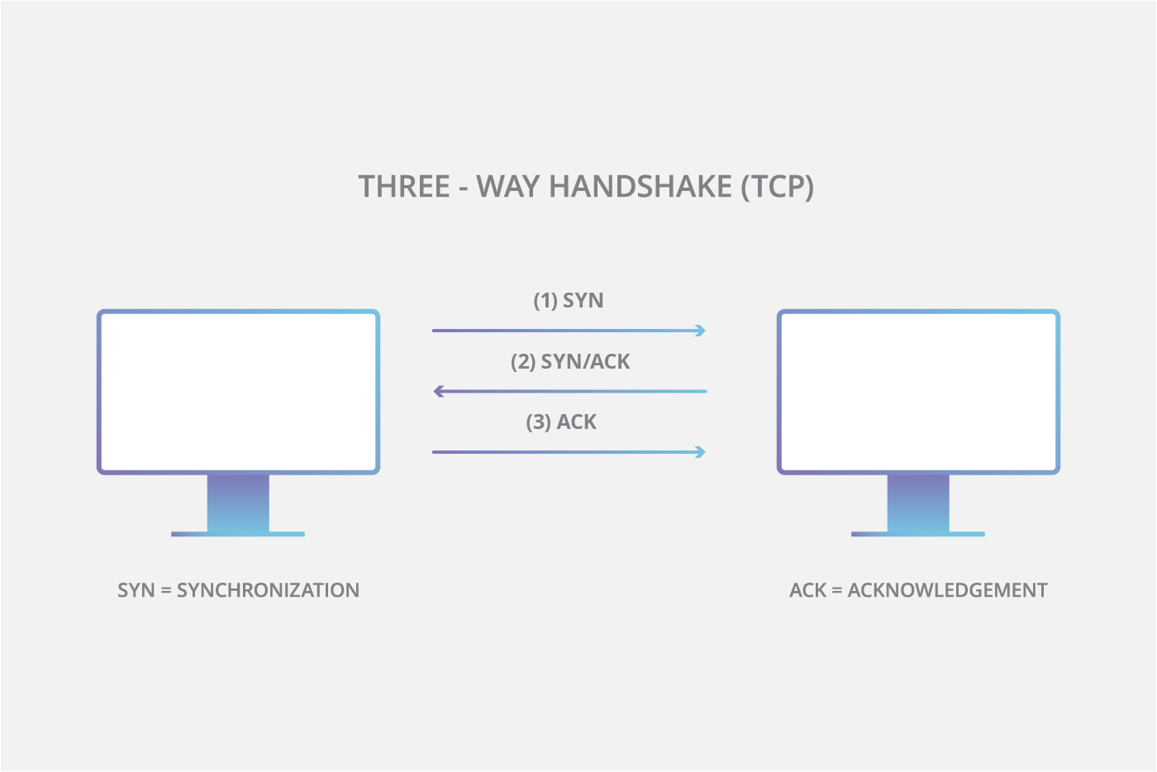
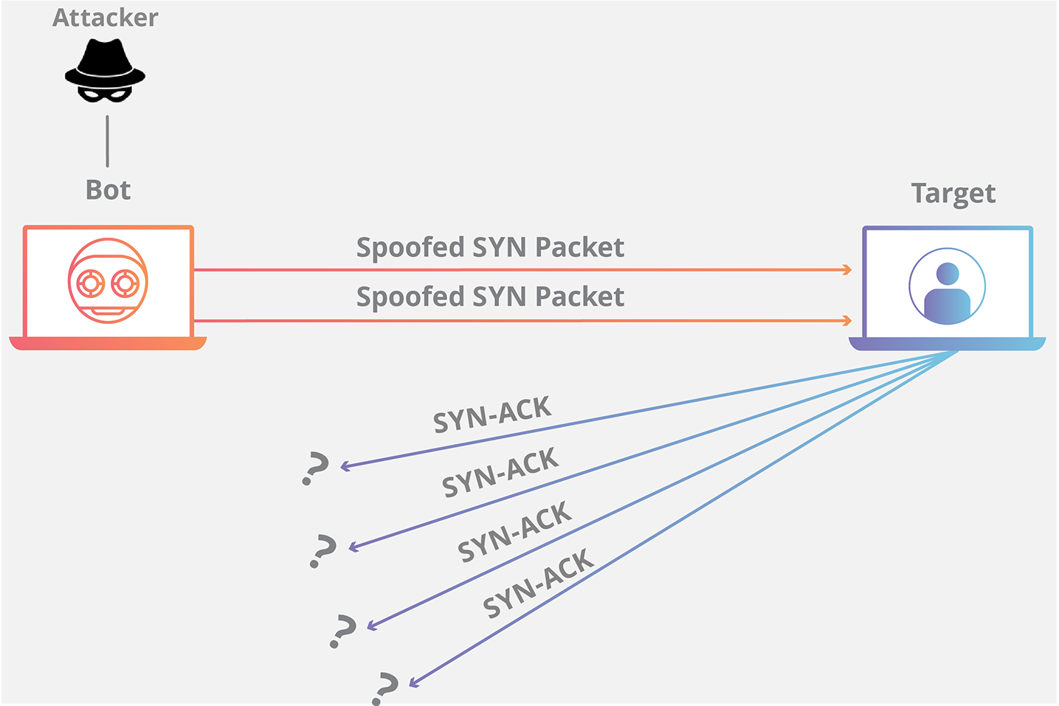
Flood attack: syn

Slide 28
Flood attack: udp
UDP flood –
A UDP flood is a type of denial-of-service attack in which a large number of User Datagram Protocol (UDP) packets are sent to a targeted server with the aim of overwhelming that device’s ability to process and respond. The firewall protecting the targeted server can also become exhausted as a result of UDP flooding, resulting in a denial-of-service to legitimate traffic.
A UDP flood works primarily by exploiting the steps that a server takes when it responds to a UDP packet sent to one of it’s ports. Under normal conditions, when a server receives a UDP packet at a particular port, it goes through two steps in response:
1. The server first checks to see if any programs are running which are presently listening for requests at the specified port.
2. If no programs are receiving packets at that port, the server responds with a ICMP (ping) packet to inform the sender that the destination was unreachable.

Slide 29
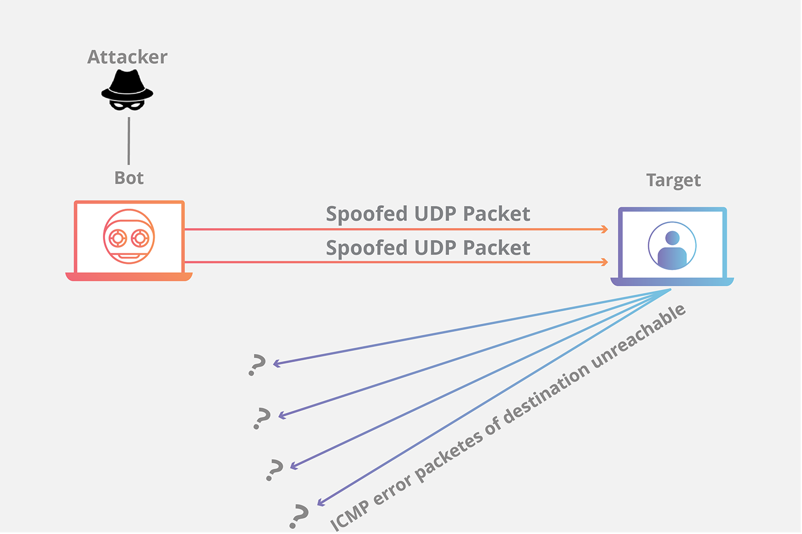
Flood attack: udp

Slide 30
DDOS attack
A distributed denial-of-service (DDoS) attack is a malicious attempt to disrupt the normal traffic of a targeted server, service or network by overwhelming the target or its surrounding infrastructure with a flood of Internet traffic.
DDoS attacks achieve effectiveness by utilizing multiple compromised computer systems as sources of attack traffic. Exploited machines can include computers and other networked resources such as IoT devices.

Slide 31
DDOS attack
How does a DDoS attack work?
DDoS attacks are carried out with networks of Internet-connected machines.
These networks consist of computers and other devices (such as IoT devices)which have been infected with malware, allowing them to be controlled remotely by an attacker. These individual devices are referred to as bots (or zombies), and a group of bots is called a botnet.
Once a botnet has been established, the attacker is able to direct an attack by sending remote instructions to each bot.
When a victim’s server or network is targeted by the botnet, each bot sends requests to the target’s IP address, potentially causing the server or network to become overwhelmed, resulting in a denial-of-service to normal traffic.
Because each bot is a legitimate Internet device, separating the attack traffic from normal traffic can be difficult.

Slide 32
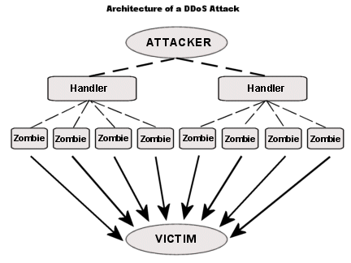
DDOS attack

Slide 33
Measures to protect against dos/ddos attack
Implementing filters on routers
Disable unused network services
Examine the physical security
Maintain regular backup schedules and policies
Maintain password policies

